Slide 1
Python Pandas

Slide 2
Pandas
Pandas is a Python library.
Pandas is used to analyze data.
Pandas is a Python library used for working with data sets.
It has functions for analyzing, cleaning, exploring, and manipulating data.
The name "Pandas" has a reference to both "Panel Data", and "Python Data Analysis" and was created by Wes McKinney in 2008.

Slide 3
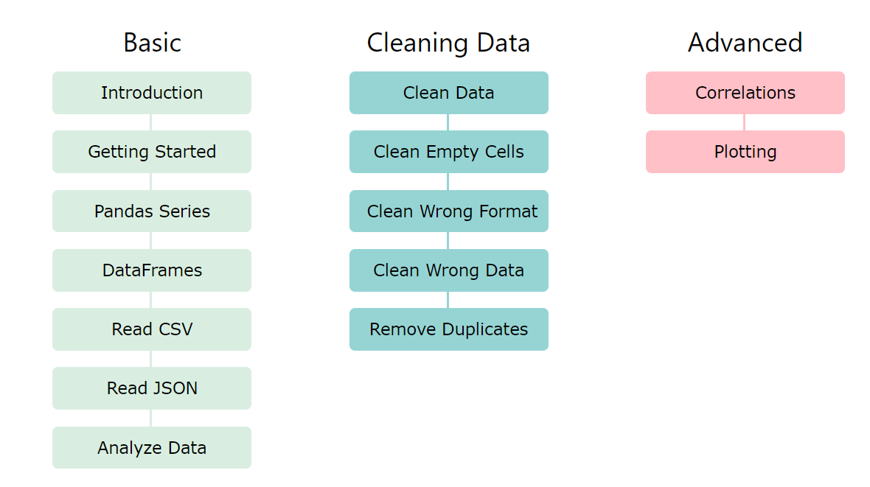

Slide 4
Use of Pandas
Pandas allows us to analyze big data and make conclusions based on statistical theories.
Pandas can clean messy data sets, and make them readable and relevant.
Relevant data is very important in data science.

Slide 5
Pandas Series
A Pandas Series is like a column in a table.
It is a one-dimensional array holding data of any type.
import pandas as pd a = [1, 7, 2] myvar = pd.Series(a) print(myvar)

Slide 6
Labels
With the index Argument you can name your own labels
import pandas as pd a = [1, 7, 2] myvar = pd.Series(a, index = ["x", "y", "z"]) print(myvar)

Slide 7
DataFrames
Data sets in Pandas are usually multi-dimensional tables, called DataFrames.
Series is like a column, a DataFrame is the whole table.
import pandas as pd data = { "calories": [420, 380, 390], "duration": [50, 40, 45] } myvar = pd.DataFrame(data) print(myvar)

Slide 8
Pandas Dataframes
A Pandas DataFrame is a 2 dimensional data structure, like a 2 dimensional array, or a table with rows and columns.
import pandas as pd data = { "calories": [420, 380, 390], "duration": [50, 40, 45] } #load data into a DataFrame object: df = pd.DataFrame(data) print(df)

Slide 9
Pandas Dataframes
Locate Row : The DataFrame is like a table with rows and columns.
Pandas use the loc attribute to return one or more specified row(s)
print(df.loc[0])

Slide 10
Named Indexes
import pandas as pd data = { "calories": [420, 380, 390], "duration": [50, 40, 45] } df = pd.DataFrame(data, index = ["day1", "day2", "day3"]) print(df)

Slide 11
Load Files Into a DataFrame
If your data sets are stored in a file, Pandas can load them into a DataFrame.
import pandas as pd df = pd.read_csv('data.csv') print(df)

Slide 12
Pandas CSV
import pandas as pd df = pd.read_csv('data.csv') print(df.to_string())
import pandas as pd df = pd.read_csv('data.csv') print(df)

Slide 13
Pandas Read JSON
import pandas as pd df = pd.read_json('data.json') print(df.to_string())

Slide 14
Pandas - Analyzing DataFrames
Viewing the Data:The head() method returns the headers and a specified number of rows, starting from the top.
import pandas as pd df = pd.read_csv('data.csv') print(df.head(10))
if the number of rows is not specified, the head() method will return the top 5 rows.

Slide 15
There is also a tail() method for viewing the last rows of the DataFrame.
The tail() method returns the headers and a specified number of rows, starting from the bottom.
print(df.tail())
Print the last 5 rows of the DataFrame
The DataFrames object has a method called info(), that gives you more information about the data set.
print(df.info())
<class 'pandas.core.frame.DataFrame'>
RangeIndex: 169 entries, 0 to 168
Data columns (total 4 columns):
# Column Non-Null Count Dtype
--- ------ -------------- -----
0 Duration 169 non-null int64
dtypes: float64(1), int64(3)
memory usage: 5.4 KB
None

Slide 16
Pandas - Cleaning Data
Data cleaning means fixing bad data in your data set.
Bad data could be:
Empty cells
Data in wrong format
Wrong data
Duplicates

Slide 17
Pandas - Cleaning Empty Cells
Empty cells can potentially give you a wrong result when you analyze data.
Return daataframe with no empty values
import pandas as pd df = pd.read_csv('data.csv') new_df = df.dropna() print(new_df.to_string())

Slide 18
Cleaning
ReplaceNULL values with 130
import pandas as pd df = pd.read_csv('data.csv') df.fillna(130, inplace = True)

Slide 19
Pandas Cleaning
Cleaningwrong Format
Cleaning Wrong Data
Remove Duplicates

Slide 20
Pandas Data Correlation
A great aspect of the Pandas module is the corr() method.
The corr() method calculates the relationship between each column in your data set.
df.corr()
Show the relationship between the columns

Slide 21
Pandas Plotting
Pandas uses the plot() method to create diagrams.
We can use Pyplot, a submodule of the Matplotlib library to visualize the diagram on the screen.
import pandas as pd import matplotlib.pyplot as plt df = pd.read_csv('data.csv') df.plot() plt.show()

